Slide 1
CONFRENCE ROOM
December-2021

Slide 2
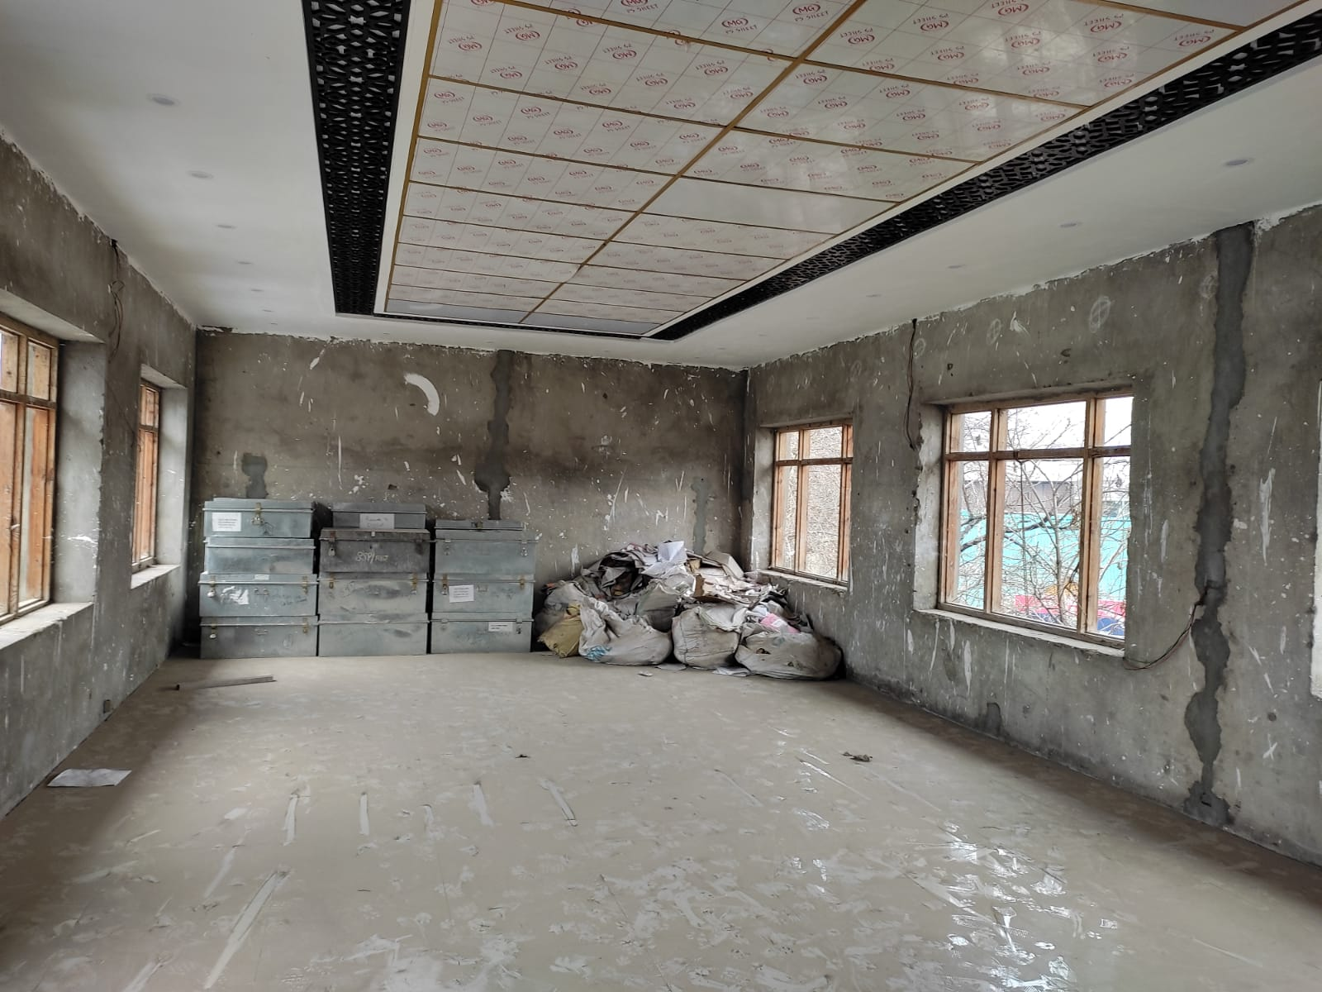
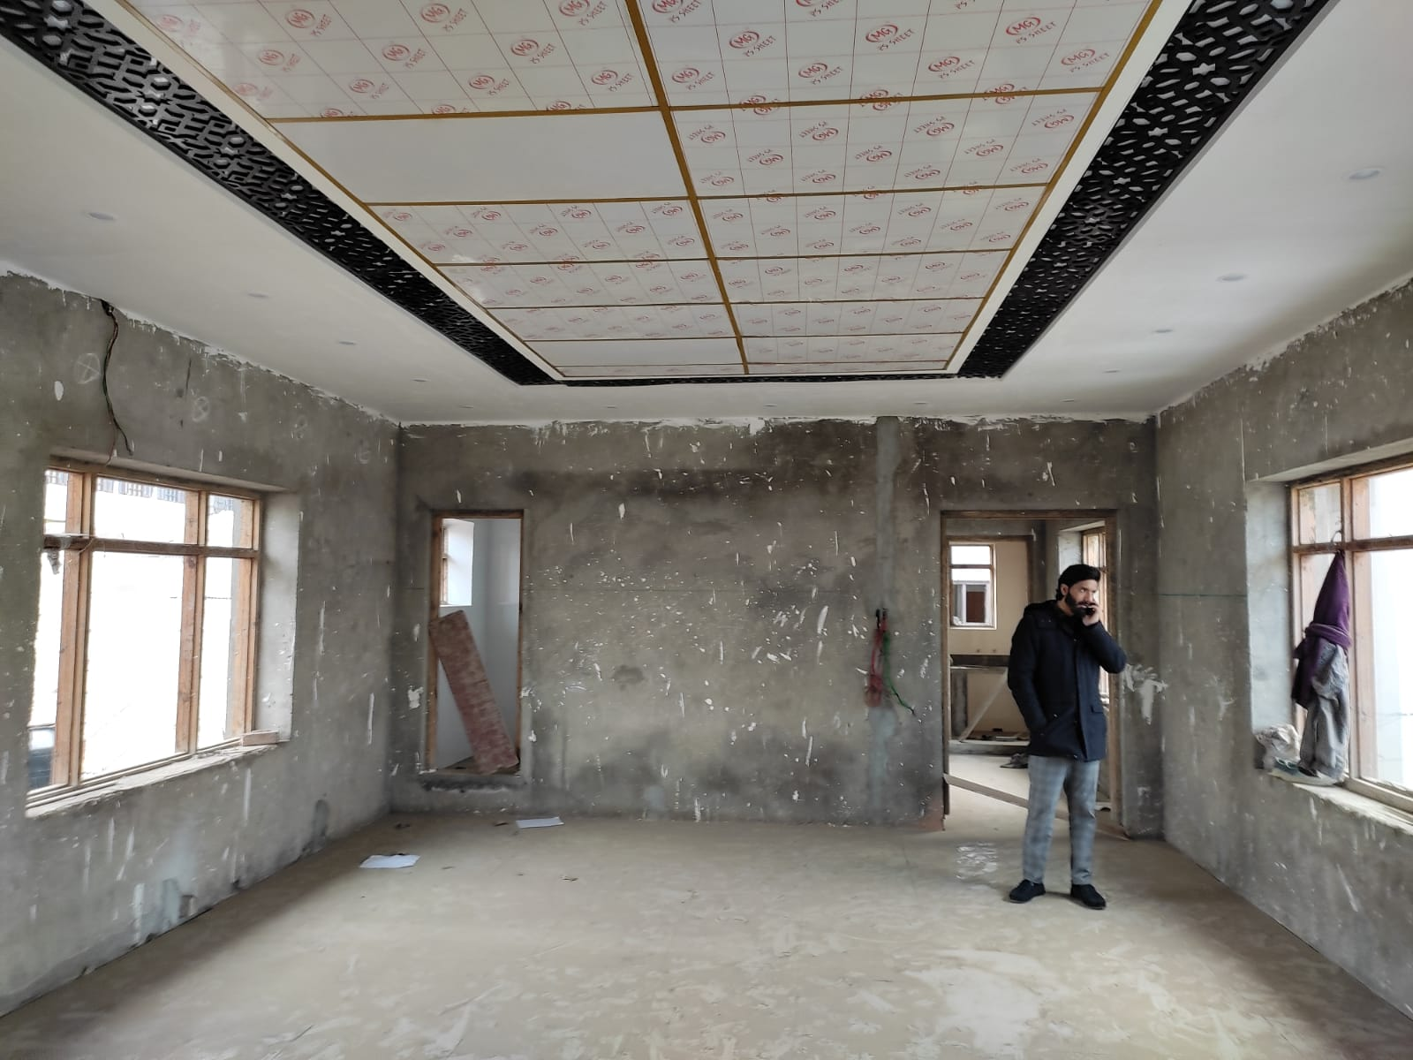
SITE CONDITION
VIEW FROM ENTRY
VIEW TOWARDS ENTRY

Slide 3
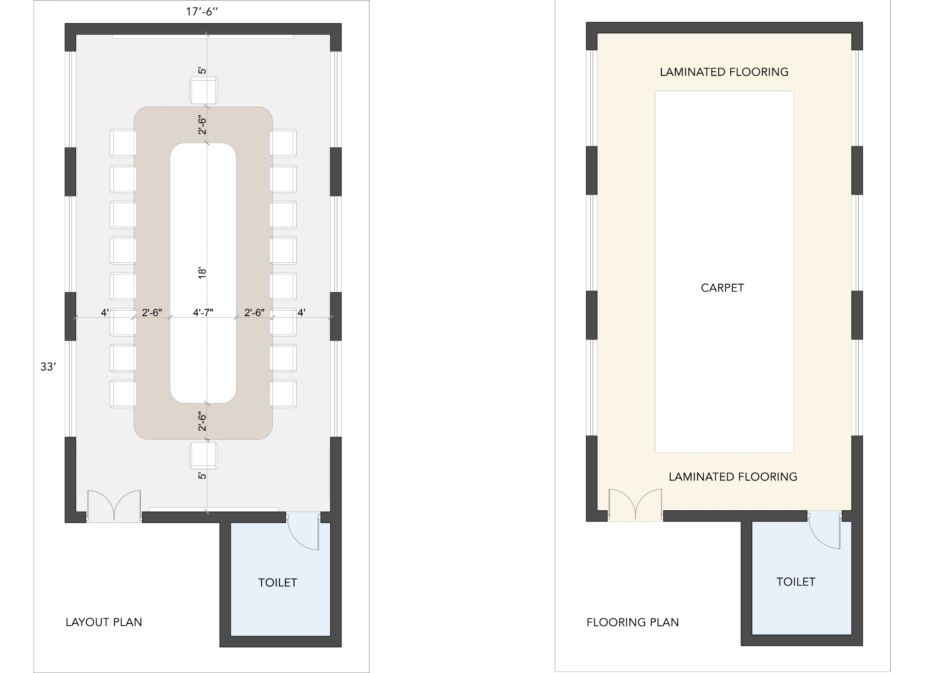
PROPOSED SITTING ARRAGENMENT AND FLOORING

Slide 4
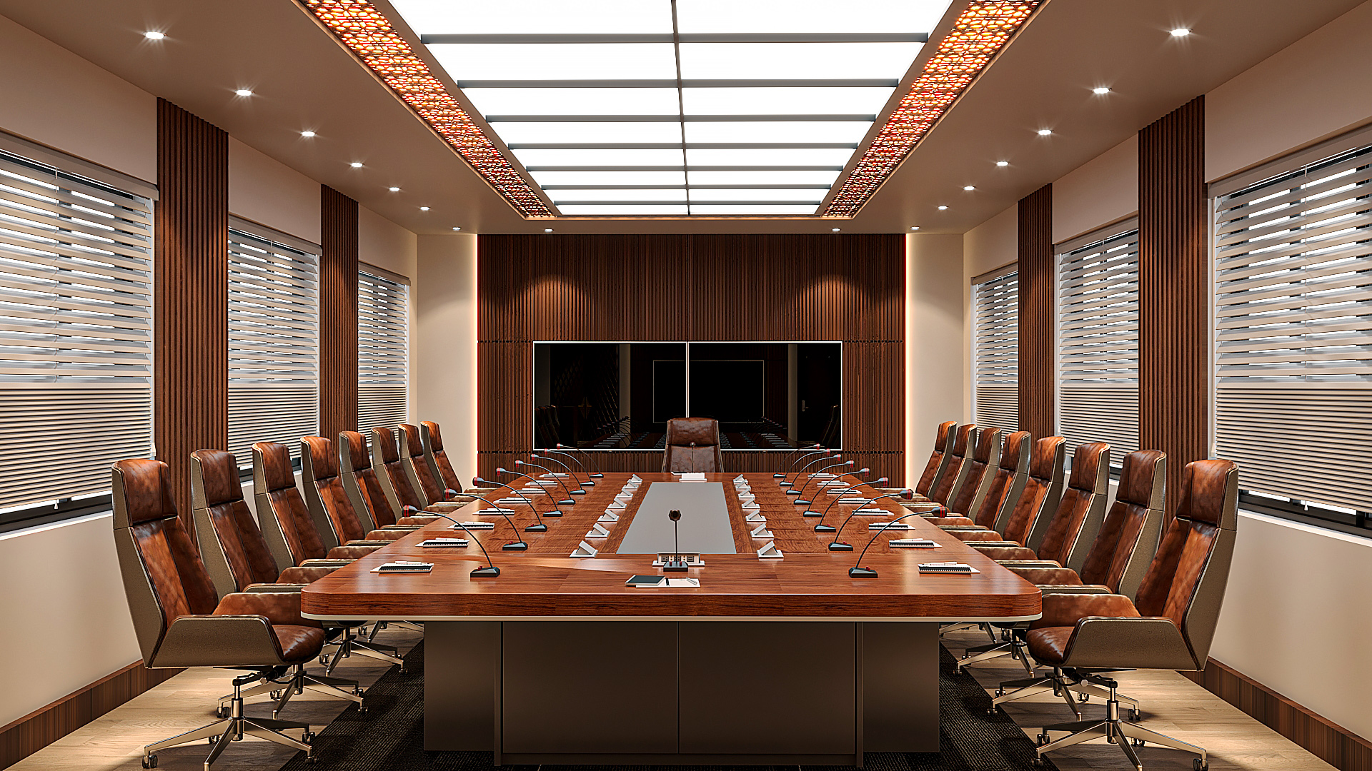
3D VIEW OPTION-1
VIEW FROM ENTRY

Slide 5
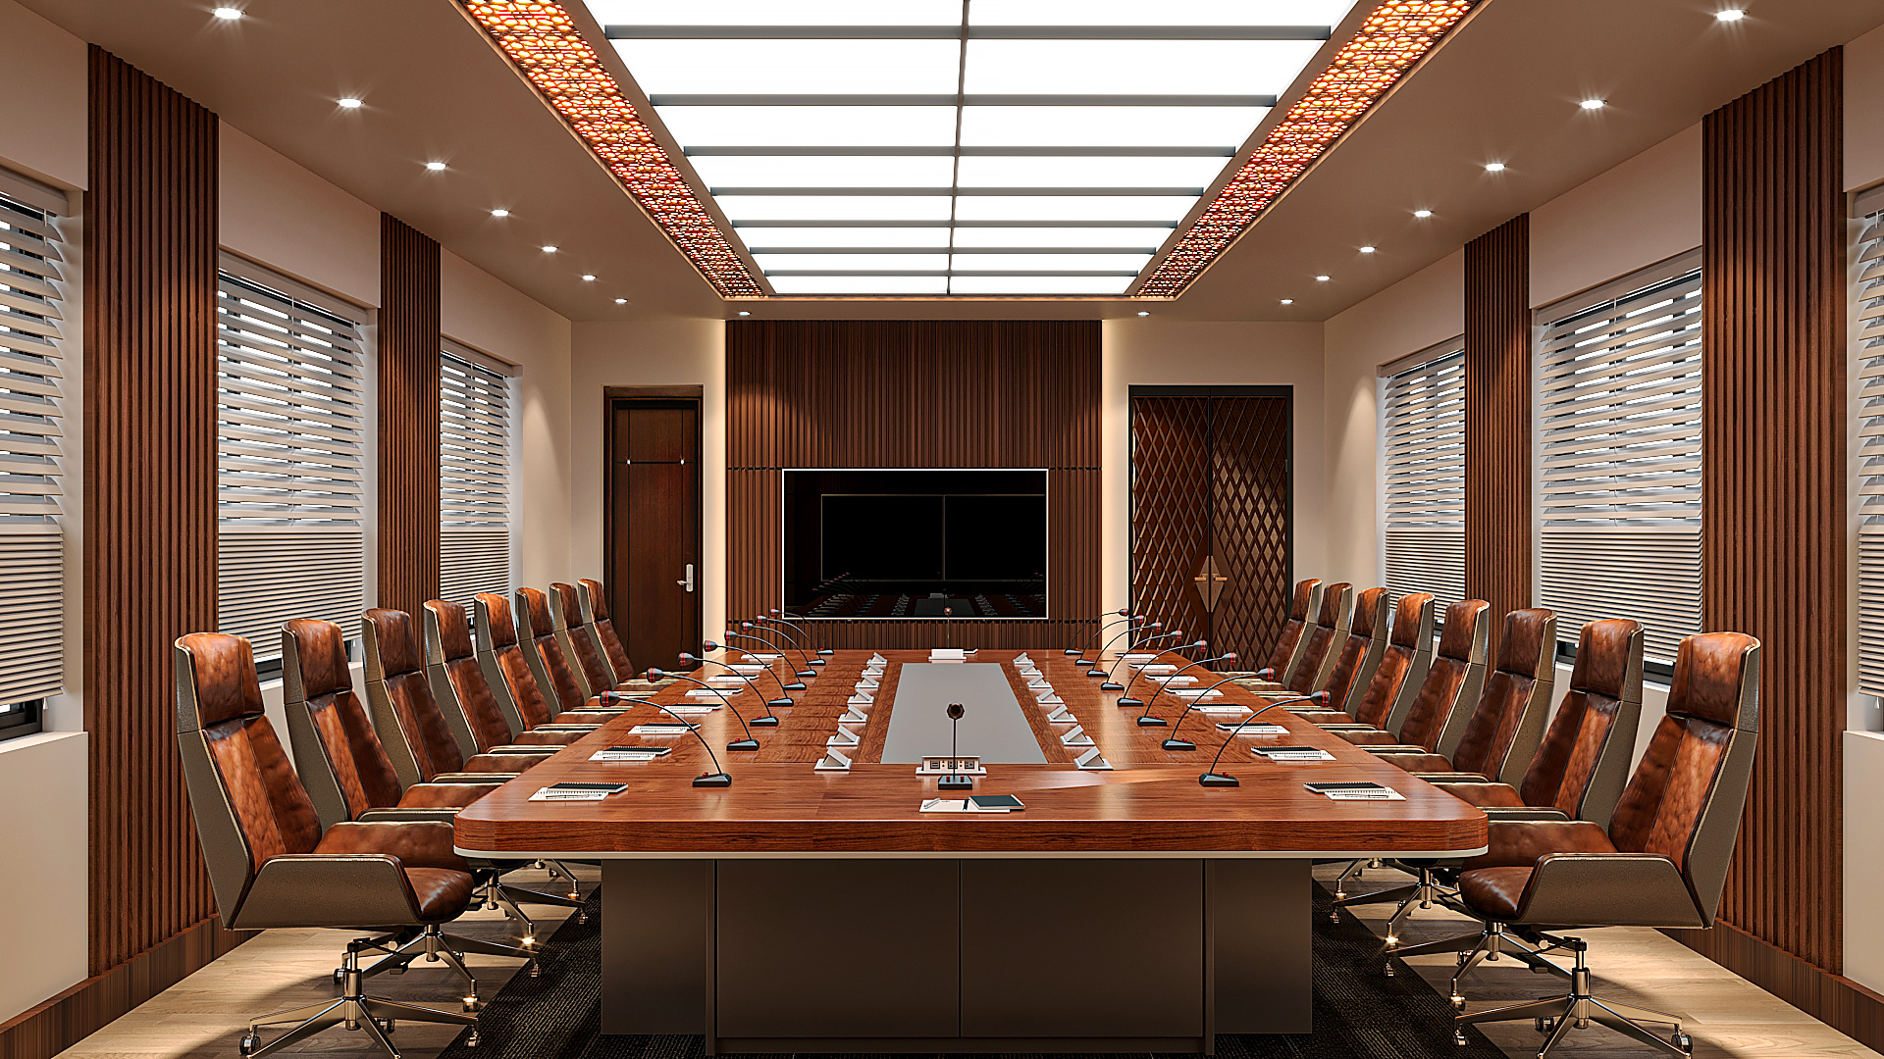
3D VIEW OPTION-1
VIEW TOWARDS ENTRY

Slide 6
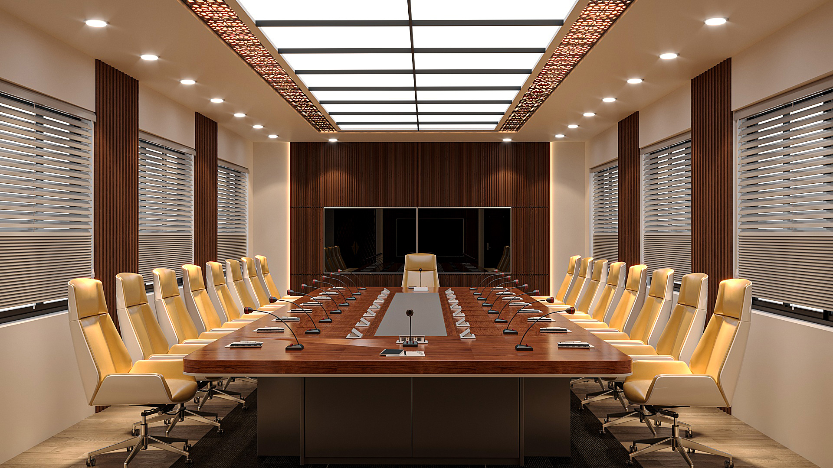
3D VIEW OPTION-2
VIEW FROM ENTRY

Slide 7
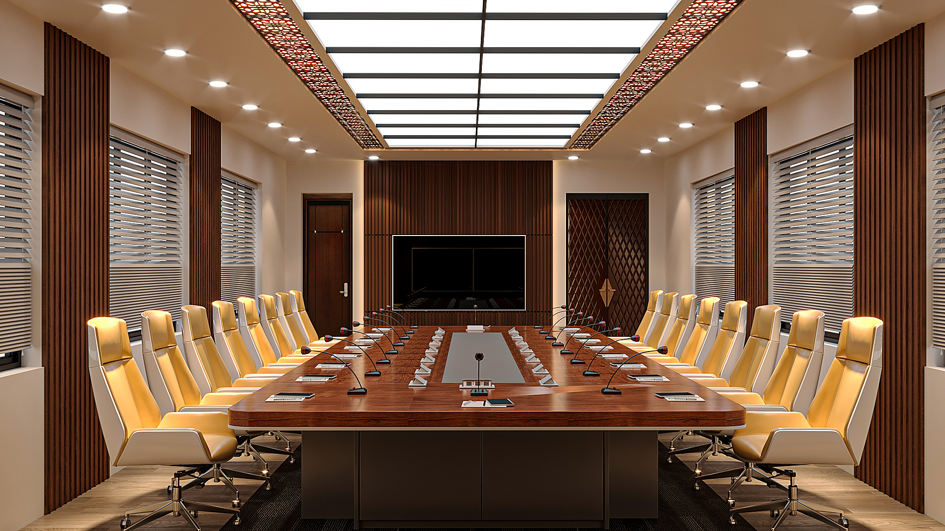
VIEW TOWARDS ENTRY

